Slide 1

Presentation On
“Sentiment Analysis of Social Media
using Artificial Intelligence”
Of
Bachelor of Computer Applications
By
Saniya Banu U01BP22S0046
Ayisha Khan M J U01BP22S0050
Disha Anilkumar U01BP22S0085
Sadiqua Simran A S U01DG22S0038
Under the guidance of
Dayananda K J
Associate professor & Hod
Dept. of BCA
DEPARTMENT OF COMPUTER APPLICATION
GSSS SIMHA SUBBAMAHALAKSHMI FIRST GRADE COLLEGE

Slide 2
Abstract
Sentiment analysis of social media content has become increasingly significant in understanding public opinion and behaviour.
This study employs a combination of advanced machine learning algorithms—specifically, Random Forest and a hybrid model integrating Decision Trees (DT) with Logistic Regression—to enhance the accuracy and effectiveness of sentiment classification.
The Random Forest algorithm, known for its robustness and ability to handle large datasets, is used to capture complex patterns and interactions within the social media text data.
Meanwhile, the hybrid DT + Logistic Regression approach leverages the strengths of both methods: Decision Trees for their interpretability and ability to model non-linear relationships, and Logistic Regression for its efficiency in binary classification tasks.
The integration of these algorithms allows for a more comprehensive analysis by combining the strengths of ensemble methods with logistic modeling.

Slide 3
Objectives
The main objective of our process is,
Create and implement a Sentiment analysis model using Random Forest and a hybrid Decision Tree (DT) + Logistic Regression approach to classify social media text into positive, negative, or neutral categories.
Assess the accuracy, precision, recall, and F1-score of the Random Forest and hybrid DT + Logistic Regression models in predicting sentiment compared to baseline methods and traditional techniques.
Analyze and address the challenges associated with the informal, nuanced, and context-dependent nature of social media language, including slang, abbreviations, and emojis.
Compare the effectiveness of the hybrid DT + Logistic Regression model with the Random Forest model and traditional Sentiment analysis techniques to identify strengths and limitations of each approach.

Slide 4
Existing system
In existing system, Sentiment analysis of social media has evolved through various approaches, each with its strengths and limitations.
Traditional Sentiment analysis systems often rely on rule-based methods or simpler machine learning algorithms.
Rule-based systems use predefined lists of words and phrases associated with positive or negative sentiments.
These systems, while straightforward and easy to implement, face significant limitations.
They struggle with the informal and diverse nature of social media language, such as slang, abbreviations, and emojis, which can lead to inaccurate sentiment classification

Slide 5
Disadvantages
Struggle with informal language, slang, abbreviations, and emojis commonly used in social media.
Lack the ability to understand the context or nuances of sentiment expressions, leading to potential misclassifications.
Require extensive manual effort to create and maintain sentiment lexicons and rules.
Difficulty in scaling to handle large volumes of diverse text data efficiently.
Can be slow and resource-heavy, especially with large datasets or high-dimensional feature spaces.
The decision boundary created by SVMs can be complex, making it hard to interpret how classifications are made.
May struggle with very large datasets, leading to longer training times and decreased efficiency.

Slide 6
Proposed system
In proposed system, the input data as sentiment dataset is taken from dataset repository. In pre-processing, we can check missing values for avoid wrong prediction and label encoding for convert the strings into numeric integer value.
Then, we can implement the NLP techniques for cleaning the text such as stop words, stem words, and remove punctuations, tokenization and padding. After that, we can implement the different vectorization techniques such as count vectorization.
Then, we can split the cleaned text into test data and train data. Test data is used for prediction and train data is used for evaluation.
The splitted data is carried out to ML algorithms such as Random forest and hybrid such as Decision Tree and logistic regression.
Finally, the system can estimate some performance metrics such as accuracy, precision, recall, f1-score and error rate.
The effectiveness of the proposed method was confirmed by comparing accuracy improvement. Here, we can predict the sentiment from user’s input such as negative or positive or neutral.

Slide 7
Advantages
Decision Tree can handle large datasets efficiently.
The experimental result is high when compared with existing system.
Time consumption is low.
Lack of ability to be spatially invariant to the input data.
Implementing text cleaning techniques like removing stop words, stemming, punctuation removal, tokenization, and padding enhances the quality of the text data, making it more suitable for analysis.
Integration of Hybrid Models: By combining Decision Tree with Logistic Regression, the proposed system benefits from the strengths of both models. Decision Trees handle non-linear relationships and complex feature interactions well, while Logistic Regression adds robustness to classification tasks, leading to more accurate and reliable predictions.

Slide 8
System requirements
SOFTWARE REQUIREMENTS:
O/S : Windows 7.
Language : Python
Software used : Anaconda Navigator – Spyder
Front End : Streamlit - Framework
HARDWARE REQUIREMENTS:
System : Pentium IV 2.4 GHz
Hard Disk : 200 GB
Ram : 4GB

Slide 9





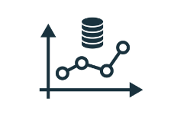


Architecture diagram
Sentiment CSV Dataset
Preliminary Process
( Handling missing values, Label encoding)
Data Slicing
(Test and Train data)
Text Preprocessing
(NLP)
Feature Extraction
(Count Vectorization)
Performance Metrics
(Accuracy and Error Rate)
Classification
(Random Forest
Hybrid (DT and Logistic Regression)
Prediction
(Positive, Negative or neutral)

Slide 10
Flow diagram
Start Project
Preliminary Process
Text Preprocessing
Data Slicing
Model Generation
Yes
Sentiment Analysis
Prediction
Performance
End Project

Slide 11
Use case Diagram
Input
Preliminary Process
Feature Extraction
System
Data Slicing
User
Classification
Performance analysis

Slide 12
Modules
Data Selection
Data Pre-processing
Text Pre-processing
Vectorization
Data splitting
Classification
Estimate Performance
Prediction

Slide 13
Data Selection
The data for this study is sourced from the Alexa sentiment analysis dataset available on Kaggle.
Dataset Link: (https://www.kaggle.com/datasets/viditsanghvi/amazon-alexa-reviews-csv-file )
This dataset contains user comments along with corresponding emotions, which are essential for understanding user reactions.
Here we can fetch or read or load the collected data by using the panda’s packages.
Our dataset, is in the form of ‘.tsv’ file extension.

Slide 14
Data Pre-Processing
Data pre-processing is a crucial step to ensure the dataset is clean and ready for analysis.
Handling Missing Values: Missing values in the dataset can lead to inaccuracies in the analysis.
Methods such as imputation (replacing missing values with mean, median, or mode) or removal of records with missing values are employed to handle these gaps in the data.
Label Encoding: To convert categorical variables (such as gender and emotions) into numerical format, label encoding is used.
This process assigns a unique integer to each category, enabling machine learning algorithms to process these variables effectively.

Slide 15
Text Preprocessing
In this step, we can implement the different Natural Language Processing techniques.
NLP is a field in machine learning with the ability of a computer to understand, analyze, manipulate, and potentially generate human language. Cleaning (or pre-processing) the data typically consists of a number of steps:
Remove punctuation: Punctuation can provide grammatical context to a sentence which supports our understanding.
But for our vectorizer which counts the number of words and not the context, it does not add value, so we remove all special characters. eg: How are you?->How are you.
Tokenization: Tokenizing separates text into units such as sentences or words. It gives structure to previously unstructured text. eg: Plata o Plomo-> ‘Plata’,’o’,’Plomo’.

Slide 16
Text Preprocessing
Remove stopwords: Stopwords are common words that will likely appear in any text. They don’t tell us much about our data so we remove them. e.g.: silver or lead is fine for me-> silver, lead, fine.
Stemming: Stemming helps reduce a word to its stem form. It often makes sense to treat related words in the same way. It removes suffices, like “ing”, “ly”, “s”, etc. by a simple rule-based approach.

Slide 17
Vectorization
In this step, we can implement the different vectorization method such as count vectorization.
Vectorizing is the process of encoding text as integer’s i.e. numeric form to create feature vectors so that machine learning algorithms can understand our data.
Both are methods for converting text data into vectors as model can process only numerical data.
CountVectorizer creates a matrix in which each unique word is represented by a column of the matrix, and each text sample from the document is a row in the matrix. The value of each cell is nothing but the count of the word in that particular text sample.
The value of each cell is nothing but the count of the word in that particular text sample.This technique converts the text into a matrix of token counts. Each word in the text is represented as a feature, and the frequency of each word in the text is captured in the matrix.

Slide 18
Data Splitting
During the machine learning process, data are needed so that learning can take place.
In addition to the data required for training, test data are needed to evaluate the performance of the algorithm in order to see how well it works.
In our process, we considered 70% of the our dataset to be the training data and the remaining 30% to be the testing data.
Data splitting is the act of partitioning available data into two portions, usually for cross-validator purposes.
One Portion of the data is used to develop a predictive model and the other to evaluate the model's performance.

Slide 19
Classification
In our process, we can implement the machine learning algorithm such as random forest and hybrid algorithms such as decision tree and logistic regression.
Random Forest: This ensemble learning method constructs multiple decision trees and merges their outputs to improve classification accuracy and prevent over fitting. It is robust and effective for complex datasets.
Hybrid Model (Voting Classifier): A hybrid model combines multiple algorithms, such as Decision Tree and Logistic Regression, using a voting classifier.
The voting classifier aggregates the predictions from each model to make a final decision. This approach leverages the strengths of each individual model to improve overall performance.

Slide 20
Estimate Performance
The Final Result will get generated based on the overall classification and prediction. The performance of this proposed approach is evaluated using some measures like,
Accuracy
Accuracy of classifier refers to the ability of classifier. It predicts the class label correctly and the accuracy of the predictor refers to how well a given predictor can guess the value of predicted attribute for a new data.
AC= (TP+TN)/ (TP+TN+FP+FN)

Slide 21
Estimate Performance
Precision
Precision is defined as the number of true positives divided by the number of true positives plus the number of false positives.
Precision=TP/ (TP+FP)
Recall
Recall is the number of correct results divided by the number of results that should have been returned. In binary classification, recall is called sensitivity. It can be viewed as the probability that a relevant document is retrieved by the query.
Recall=TP/ (TP+FN)

Slide 22
Prediction
After training and evaluating the models, the system is used to predict user input based on users emotion.
The final model is deployed to classify incoming comments, providing insights into user emotions and enabling the development of personalized content strategies.

Slide 23
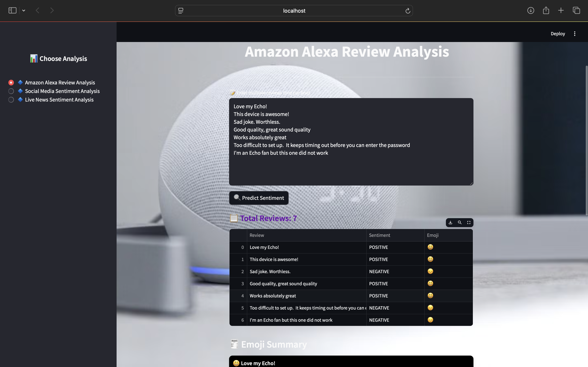
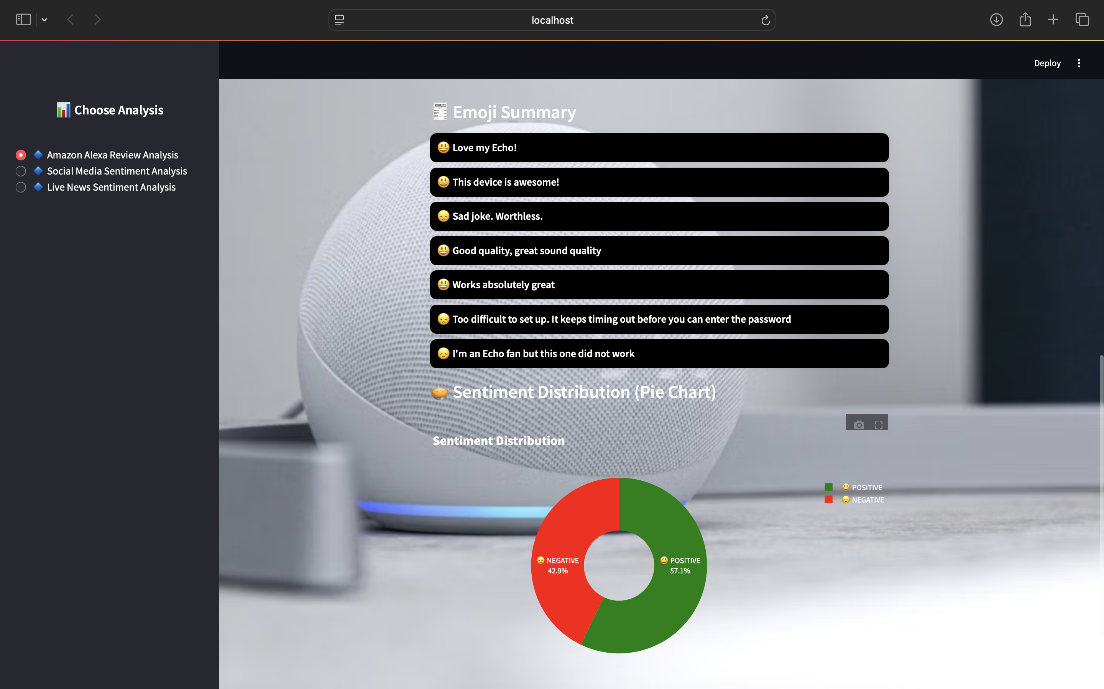
Output

Slide 24
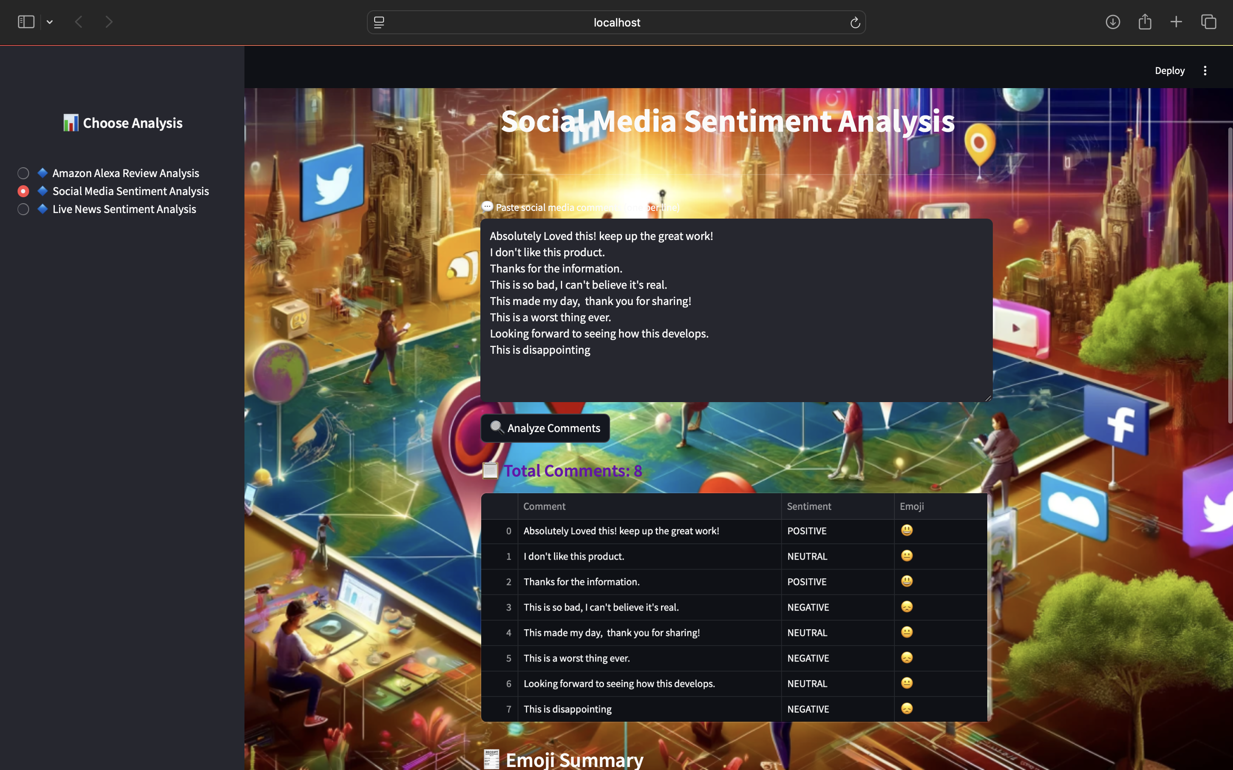
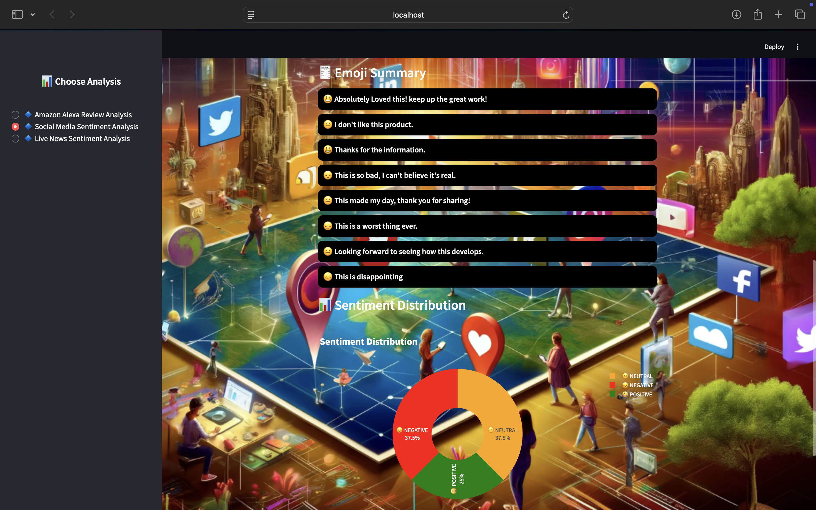

Slide 25
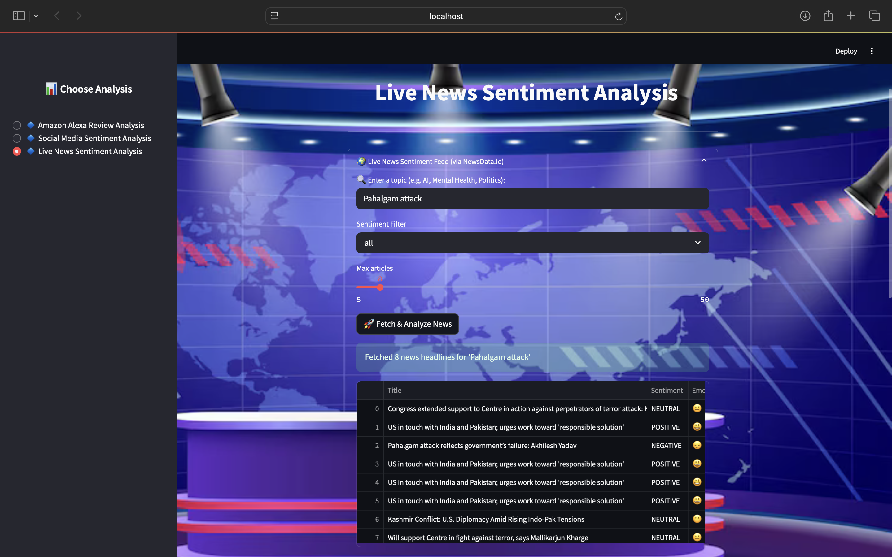
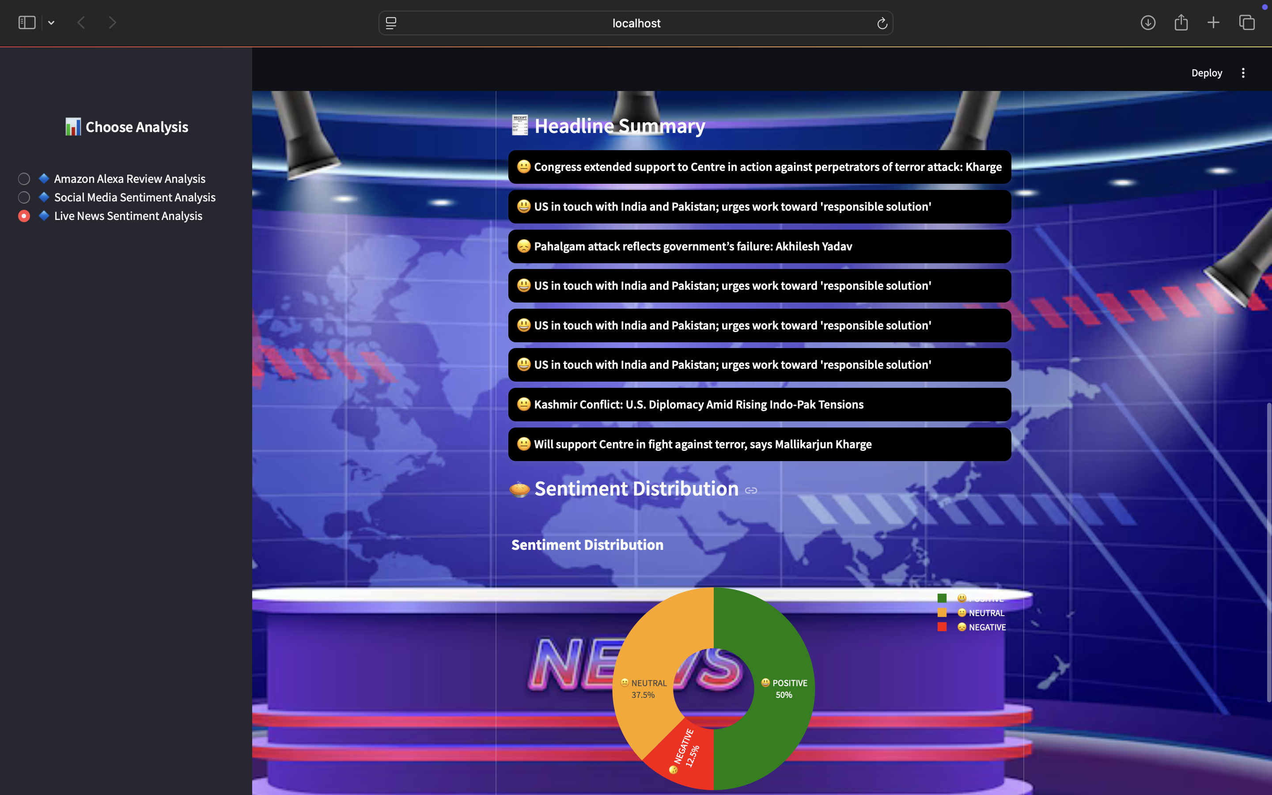

Slide 26
Conclusion
The proposed sentiment analysis system, incorporating advanced preprocessing techniques, robust machine learning algorithms, and comprehensive evaluation metrics, represents a significant advancement in accurately classifying sentiment from social media and other text sources.
By leveraging a combination of Random Forest and a hybrid model integrating Decision Tree and Logistic Regression, the system benefits from the strengths of ensemble methods and individual model interpretability.
The rigorous preprocessing steps—such as handling missing values, label encoding, text cleaning, and vectorization—ensure high-quality input data, leading to more reliable predictions.
Furthermore, the system's performance is meticulously assessed using key metrics like accuracy, precision, recall, F1-score, and error rate, providing a thorough understanding of its effectiveness.

Slide 27
Thank You…

